Slide 1
Section 5.6 Natural Logarithms
© Copyright All Rights Reserved Homework Depot www.BCMath.ca

Slide 2
What is Natural Log?
A “Natural Logarithm” is a logarithm when it has a base of “e”
“e” is known as “Euler’s Number” and is used in situations involving continuous growth/decay in an exponential scenario
Compound Interest with “n” compounds in a year
Continuous Compound
Euler’s Number “e”
(Irrational)

Slide 3
Evaluating Natural Logarithm?
Most calculators have a natural log button that evaluates natural logs
When simplifying or evaluating natural logs, the same log rules apply
Ex: Evaluate the following:
© Copyright All Rights Reserved Homework Depot www.BCMath.ca

Slide 4
Ex: Evaluate each of the following natural logs without a calculator

Slide 5
Solving Equations with natural Logs:

Slide 6
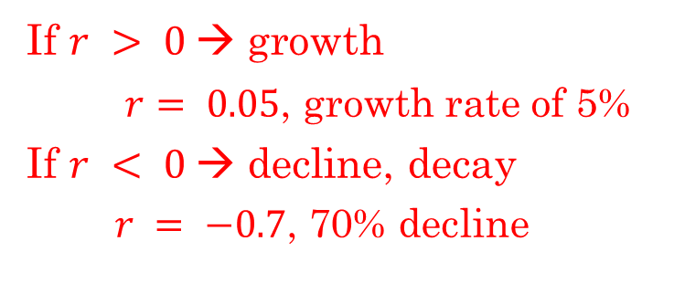
What is “euler’s Number ‘e’?
The value of “e” was discovered in 1683 by a swiss mathematician name Jacob Bernoulli
He was studying compound interest, the effects of compounding infinitely many times within a year
Continuous Compound
Compound Interest:
What would happen if
If $r > 0$→ growth
$r= 0.05$, growth rate of 5%
If $r < 0$→ decline, decay
$r = −0.7$, 70% decline
n: The number of compounds in a year
e= 2.7182818284590452353602874713527……
If you replace “n” with a very large number, the value of this equation will get closer to the true value of “e”

Slide 7
Ex: An investment policy pays an interest rate of 100% for one year. If one dollar is invested and the number of compounds in a year increases, how much will be accumulated?
Number of Compounds
© Copyright All Rights Reserved Homework Depot www.BCMath.ca

Slide 8
As the number of compounds goes to infinity, the formula changes:
Whenever we have continuous compounding, we use this formula, and a base of “e”
Ex: The population of a particular country is 32 million. Assuming the population is growing continuously at a rate of 2.7%, find the population P, in millions, 20 years from now.
© Copyright All Rights Reserved Homework Depot www.BCMath.ca

Slide 9
Other definitions of Euler’s Number:
Maclaurin Series
Continued Fraction:

Slide 10
Applications of Continuous Compounding
Many events in the real world compound on a continuous rate
ie: Compounded by the second, millisecond,…etc
Each compounding period becomes infinitely small
Population growth in a country
babies born any second (day/night)
Immigration
Radioactive Decay
Carbon 14 decays at a continuous rate
Does not lose a fixed weight in a single compound of several thousand years
© Copyright All Rights Reserved Homework Depot www.BCMath.ca

Slide 11
Ex: The population of Thailand in 2007 is 63 million and is growing at a rate of 1.2% annually. Assuming the country’s population is continuously growing, in how many years will the population be 120 million?
Practice: The population of metro-Vancouver in 2008 is at 2.25million. If the population continues to grow at a continuously compounding at a rate of 1.5%, when will the population to reach 3.5 million?
Practice: An radio-active substance was weighed in two separate times 120 seconds apart. First measurement weighed 500g, second measurement weighed 115g. If a 3rd measurement was weighed 60s after the 2nd measurement, how many grams will the substance weigh?

Slide 12
Ex: James invests in a fund that compounds continuously at a rate of 4.5% for 7 years. Tom invests in a bank where interest is compounded monthly. At what interest rate would Tom need to have to get the same return at James?
ii) The formula for the weight (W) of a radioactive substance after “t” seconds, is given by the formula below. Where ‘P” is the initial weight (grams). What is the half life of the substance?
iii) The half life of c-14 is 5570 years. The equation for the mass of C-14 after “t” years is given by the formula below. Find the value of “k”. What is the weight of 2000g of C14 after 1900 years?

Slide 13
Ex: The population of Thailand in 2007 is 63 million and is growing at a rate of 1.2% annually. Assuming the country’s population is continuously growing, in how many years will the population be 120 million?
In 2061ad, (54 years) the
population of Thailand will
reach 120 million people if the
rate of growth continues.
© Copyright All Rights Reserved Homework Depot www.BCMath.ca

Slide 14
Practice: The population of metro-Vancouver in 2008 is at 2.25million. If the population continues to grow at a continuously compounding at a rate of 1.5%, when will the population to reach 3.5 million?
In 2038ad, (30 years) the
population of Vancouver will
reach 3.5 million people if the
rate of growth continues.
© Copyright All Rights Reserved Homework Depot www.BCMath.ca

Slide 15
Natural Log Rules:
Log rules from section 2.3 also apply with Natural logs
© Copyright All Rights Reserved Homework Depot www.BCMath.ca

Slide 16
Practice: Which of the following expressions is equal to
the following:
ii) Which of the following is equal to:
iii) Solve for “t”
iv) Solve for “x”
© Copyright All Rights Reserved Homework Depot www.BCMath.ca

Slide 17
Challenge Problems:
i) Let ‘x’ and ‘y’ be positive numbers. Find the value of “x” [AIME]
ii) Determine all real solutions to the system of equations and prove that there are no more solutions
iii) Find the product of the two positive roots of the equation: [AIME]

Slide 18
Challenge Problems:
i) Let ‘x’ and ‘y’ be positive numbers. Find the value of “x” [AIME]
Change both expressions back to logarithm form. Be mindful of the restrictions:

Slide 19
ii) Determine all real solutions to the system of equations and prove that there are no more solutions
Add all three equations together: Be mindful of the restrictions
NOpE!....

